Slide 1
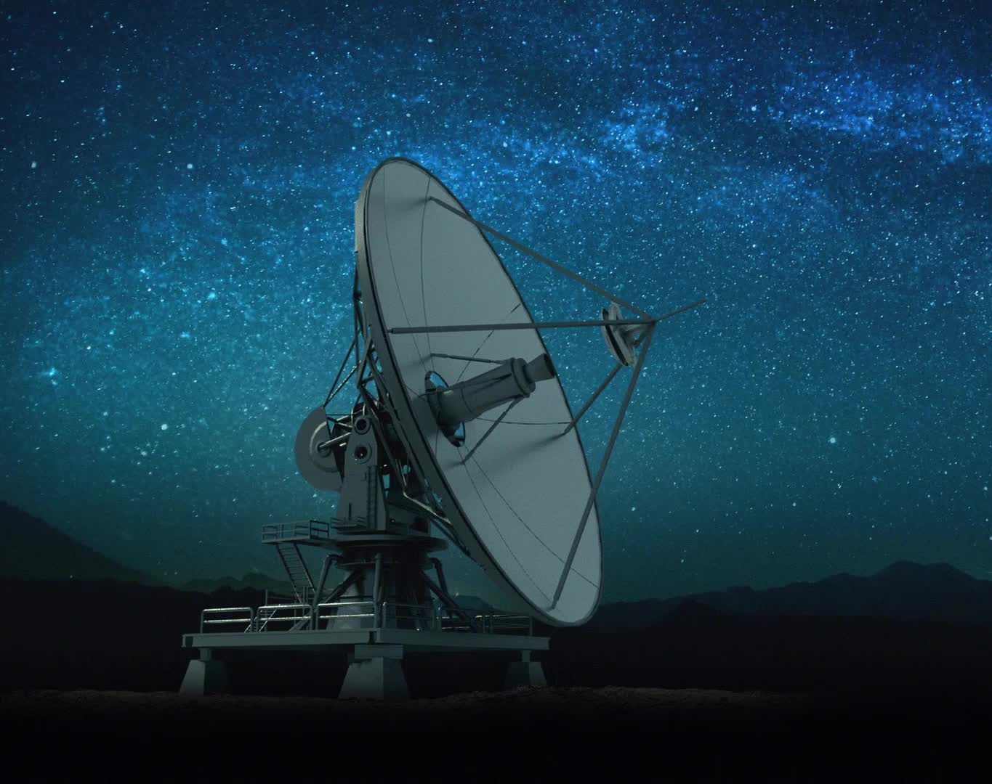



Machine Learning in Astronomy
Francisco M. Montenegro Montes María Zambrano fellow, UCM, IPARCOS
2nd IPARCOS Workshop on Machine Learning and
Applications to Physics, 18-20 Dec 2023

Slide 2
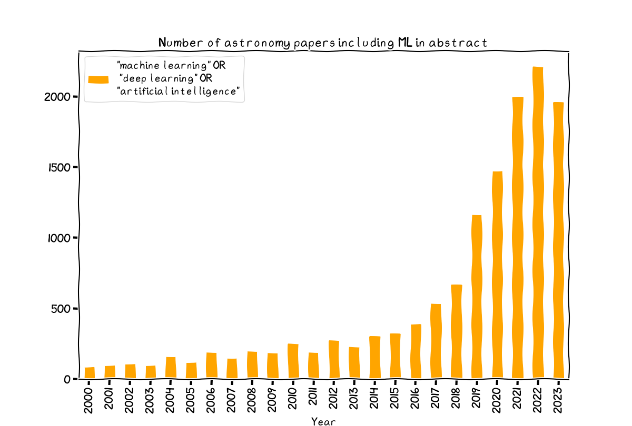
Source: NASA ADS. https://ui.adsabs.harvard.edu/

Slide 3
Explosive increase in the use of ML techniques in the last 5-10 years
Bigger and more complex datasets available (open source). ML is almost a necessity. And the future will become more demanding (Rubin, SKA).
Techniques become more popular and better known.
Success stories involving citizen science projects.
Availability of better computing infrastructures (GPUs, cloud services) and more funding for AI-based projects.
No ethical issues like privacy concerns or biases that may affect other disciplines.

Slide 4
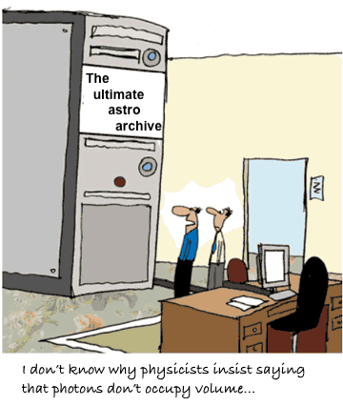
“Observatories’ data storage costs will threaten their budgets. Data transport latency and bandwidth will threaten not just budgets, but available technology and human patience”.
R. Seaman et al. 2007. ADASS XVI Meeting

Slide 5
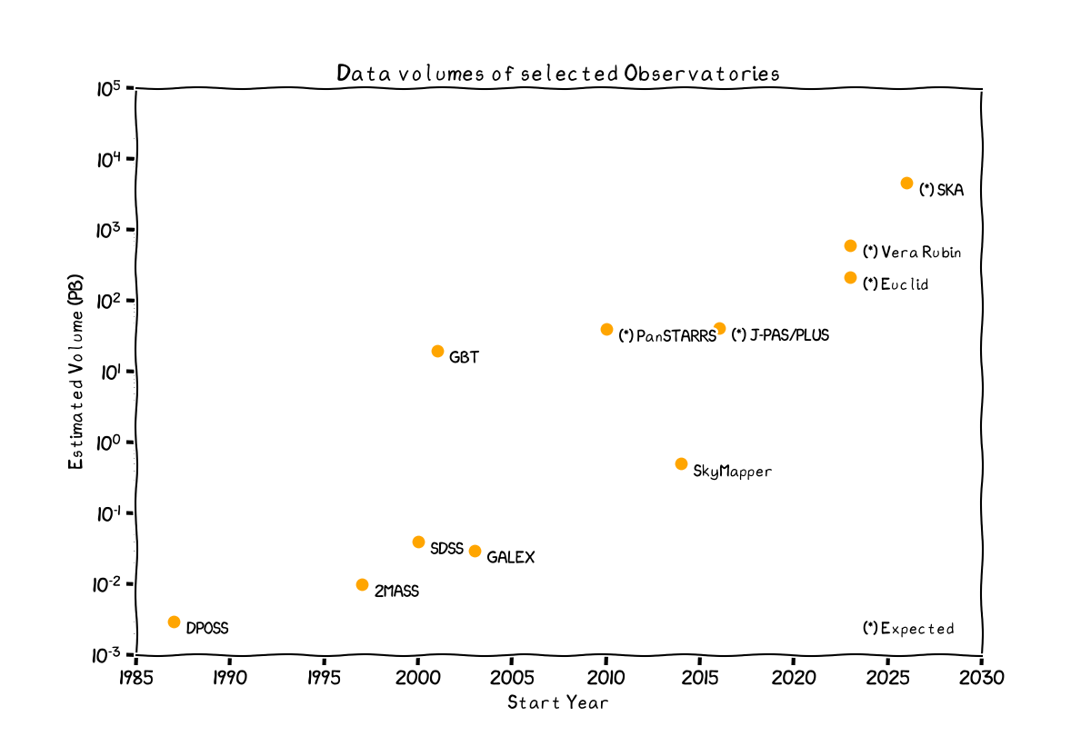

Slide 6
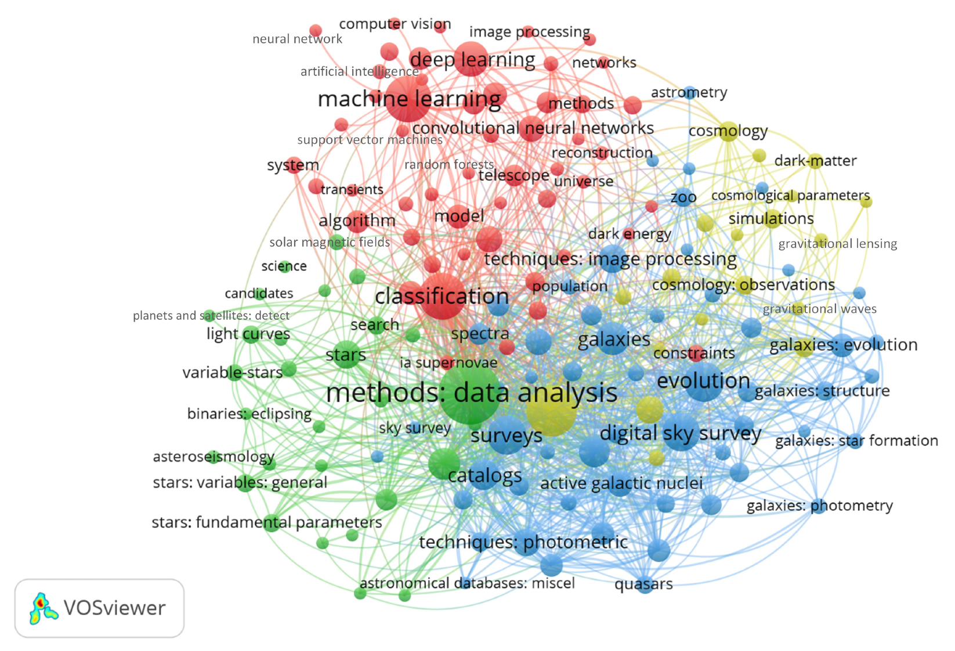
Includes AI and ML techniques applied to the fields of astronomy and astrophysics
Application of AI and ML in the field of stellar analysis.
Study of cosmology using AI and ML methods
Analysis of galaxies by means of AI and ML techniques
Rodríguez et al. 2022. On the application of machine learning in astronomy and
astrophysics: A text-mining-based scientometric análisis. (~2700 papers published between 1989 and 2021)
Notes:
VOSviewer is a software to identify keywords used in research articles and generates bibliometric maps (landscapes) using the mapping technique called “visualization of similarities” a type of dimensionality reduction and clustering technique.
The study utilized VOSviewer for semantic analysis to create a map highlighting key subjects related to the application of AI/ML in astronomy and astrophysics. Initially identifying 4181 relevant keywords in the WoS database, the authors narrowed it down to 157 by setting a minimum threshold of 10 keyword occurrences. Through clustering, these keywords were categorized into five main clusters based on their similarities. The clusters represent co-occurrence patterns among key terms, with circle size indicating frequency. Although the process was automated, the authors provided additional interpretation to enhance understanding. The study, reviewing nearly 2800 documents from WoS, offers a concise overview of recent and explanatory topics identified by the clusters, emphasizing it is not an exhaustive review of all potential inputs.
Red cluster: Terms referring to the different AI and ML methods that can be applied to astronomy and astrophysics to analyze the datasets. Five main ML techniques are considered in the astronomical and astrophysical fields, namely: Principal Component Analysis (PCA), Decision Trees (DT), Random Forests (RF), Support Vector Machines (SVM), and Artificial Neural Networks (ANN).
Green (Yellow, Blue) : Study of stars (cosmology, galaxies) within the scope of AI and ML applications.

Slide 7
Classification: Categories or labels are applied to objects or features. Based on a training set (labeled or unlabeled),
the algorithm learns the characteristics that relate an instance to a category. When applied to a new instance, the algorithm assigns the most likely category label.
Regression: Assignment of a numerical value (or values) based on the characteristics that are learnt or otherwise
predicted by the machine learning algorithm. As with classification, a training set may be used or the characteristics
may be inferred from the dataset.
Clustering: Determine whether an object or a feature is part of (i.e., a member of) something. This might be a physical structure or association—as in the more familiar usage of the term in astronomy as applied to open, globular, or galactic clusters—or a region within an N-dimensional parameter space.
Forecasting: The purpose of the machine learning algorithm is to learn from previous events, and predict or forecast
that a similar event is going to occur. There is an implicit time-dependence to the prediction.
Generation and reconstruction: Missing information is created, expected to be consistent with the underlying truth.
The cause of the missing information might be due to the presence of noise, processing artifacts, or additional astronomical phenomena, all of which conspire to obscure the required signal.
Discovery: New celestial objects, features, or relationships are identified as a consequence of the application of a ML or AI method.
Insight: Moving beyond the discovery of celestial objects, new scientific knowledge is demonstrated as a consequence of applying machine learning or AI. This includes cases where insight is gained into the suitability of applying machine learning, choice of data set, hyperparameters, and comparisons with human-based classification.
Complexity or maturity in the use of ML/AI
Fluke & Jacobs 2019

Slide 8
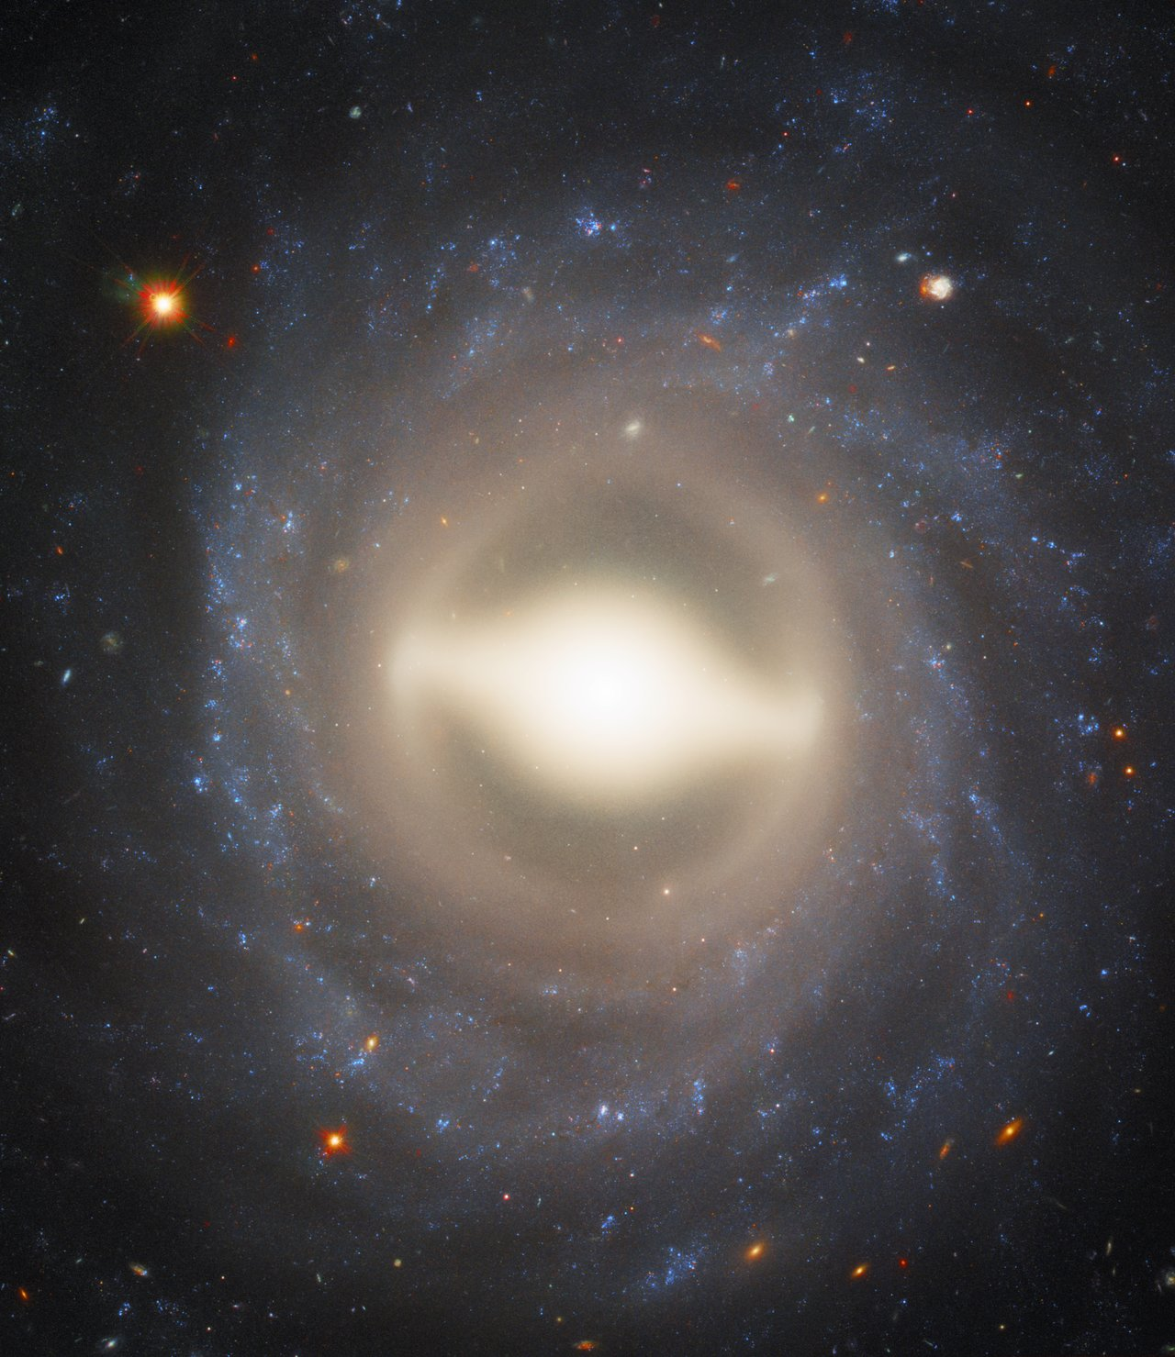
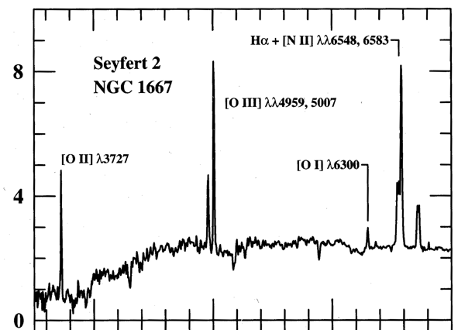
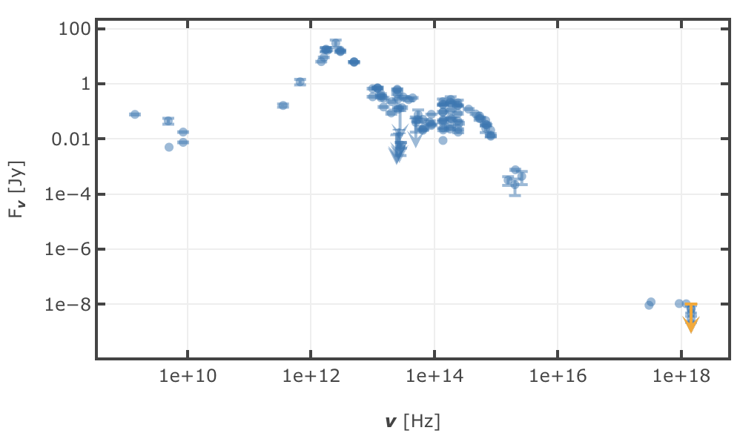
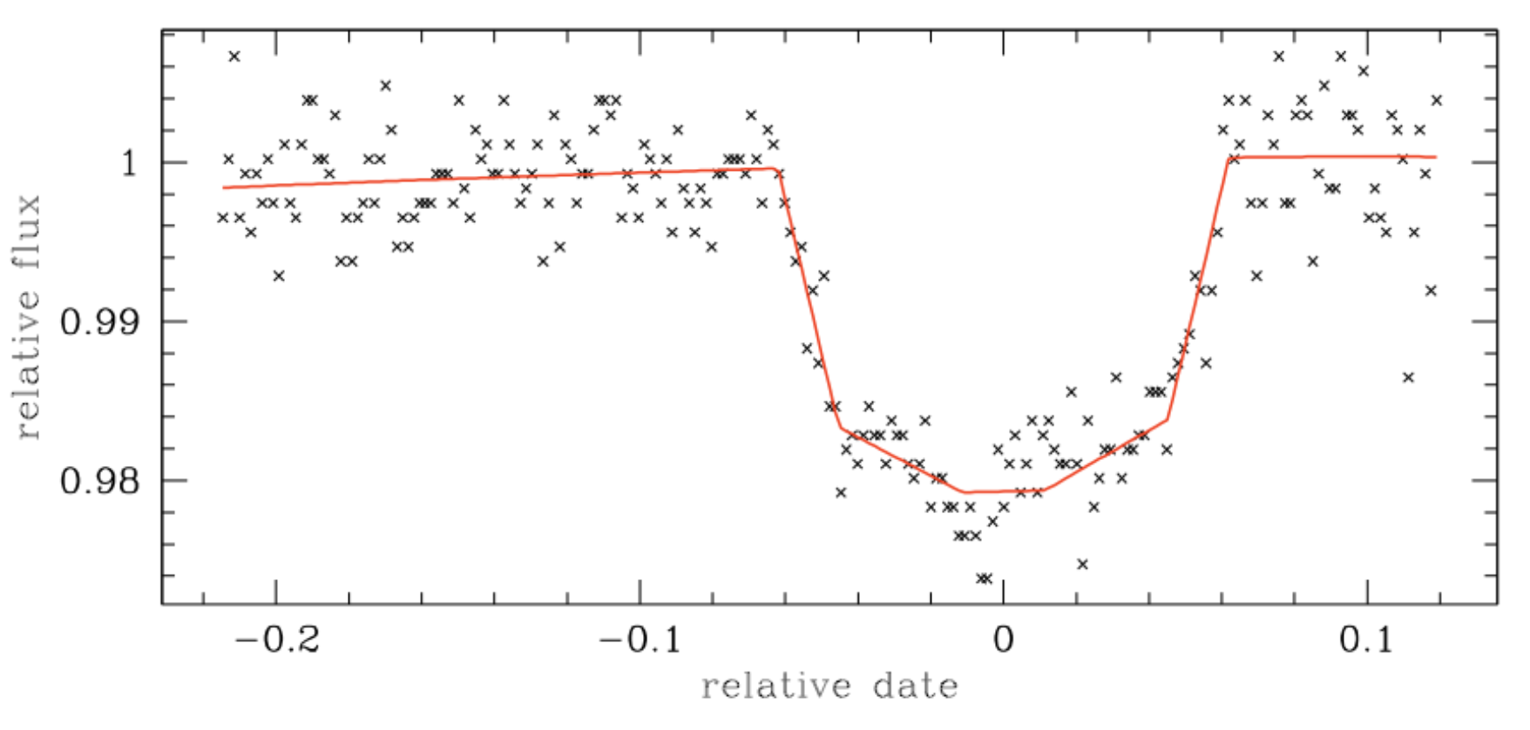
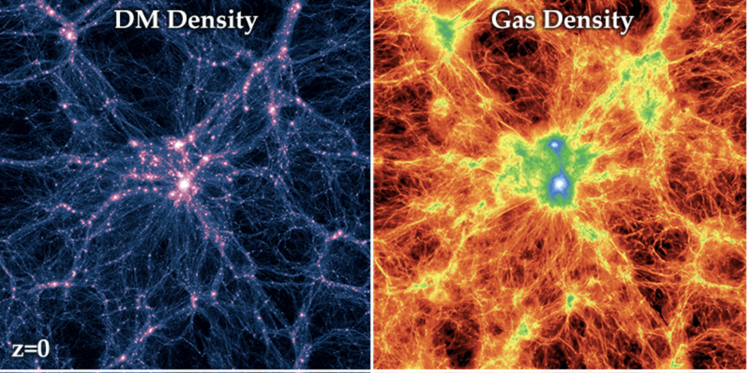
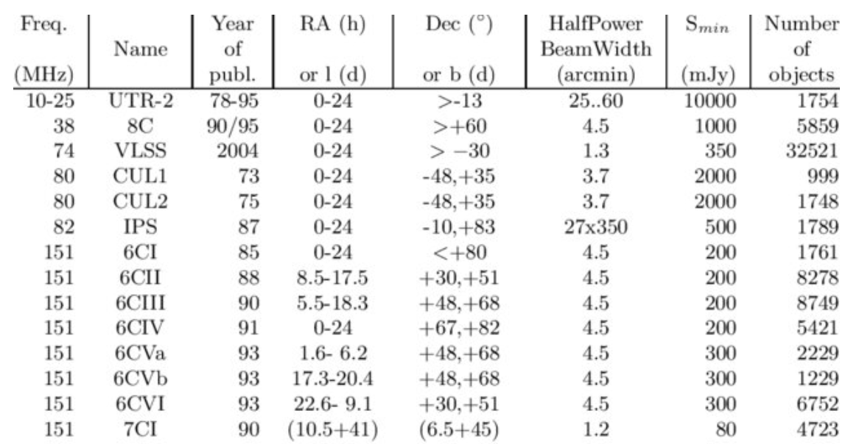
Types of astronomical data where ML is normally applied
Images
Spectra
Spectral energy distributions
Lightcurves / Time series
Astronomical catalogues
Simulations

Slide 9
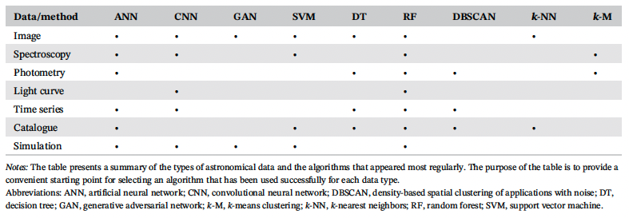
Fluke & Jacobs 2019

Slide 10
Applications at different levels of maturity
Classification and forecasting of solar flares. Segmentation for identification of umbra/penumbra/photosphere in the solar surface.
Established
Progressing
Emerging
Identification of candidates to extrasolar planets from stellar lightcurves (Kepler)
Stellar and photometric classification of stars, leading to finding new objects of specific types of stars (WR, hot sub-dwarfs, etc).
Classification of galaxies from optical and radio imaging surveys. Prediction of physical properties from emission-line spectra. Identification of galaxies undergoing a special evolutionary phase as predicted by simulations.
Identification and classification of transient objects.
Accurate estimation of distance to extragalactic objects from photometric information (photometric redshift).
Identification of systems affected by gravitational lenses in wide-area surveys
Discriminating noise from signal in the detection of gravitational waves.
Notes:
The algorithm is well established to tackle the problems we want to solve.
There is a substantial body of knowledge and literatura about these topics
Forecasting, discoveries and insight.

Slide 11
Applications at different levels of maturity
Established
Progressing
Emerging
Reduction of false detections from the moving objects detection pipelines. Detection and classification of asteroids.
Assigning morphological types to radio-detected AGNs.
Identification of blazar candidates in catalogues of high-energy sources (Fermi-LAT)
Detecting high-redshift extremely luminous quasars
Discriminating populations of BAL QSOs from non-BAL QSOs
Examination of the output of cosmological simulations to connect physical properties of galaxies, dark matter halos and the cosmic environment.
Classification of DM sub-halos. Assignment of galaxies to halos in simulations.
Notes:
Broad number of techniques applied to solve a particular problema
A single technique has been used several times
There is an immediate move to discovery and insight.

Slide 12
Applications at different levels of maturity
Established
Progressing
Emerging
Planetary metheorology: Classification of atmospheric features on the Surface of Mars aiming at predicting dust storms.
Discovery of previously unknown impact craters.
Study of the ISM in our Galaxy. Spatial or chemical clustering of components in atomic and molecular clouds.
Determination of dust reddenning in millions of stars, with application to GAIA data. Discovery of new open clusters from overdensities in GAIA DR2 data
Identify faults in telescope drive systems that can be tackled in real time with automated expert systems
Notes:
Disciplines starting to explore the use of ML normally trying to get the low-hanging fruit.

Slide 13
A few success stories…

Slide 14
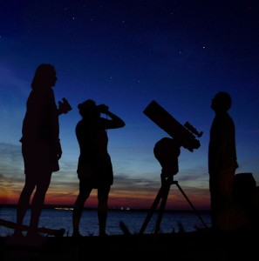
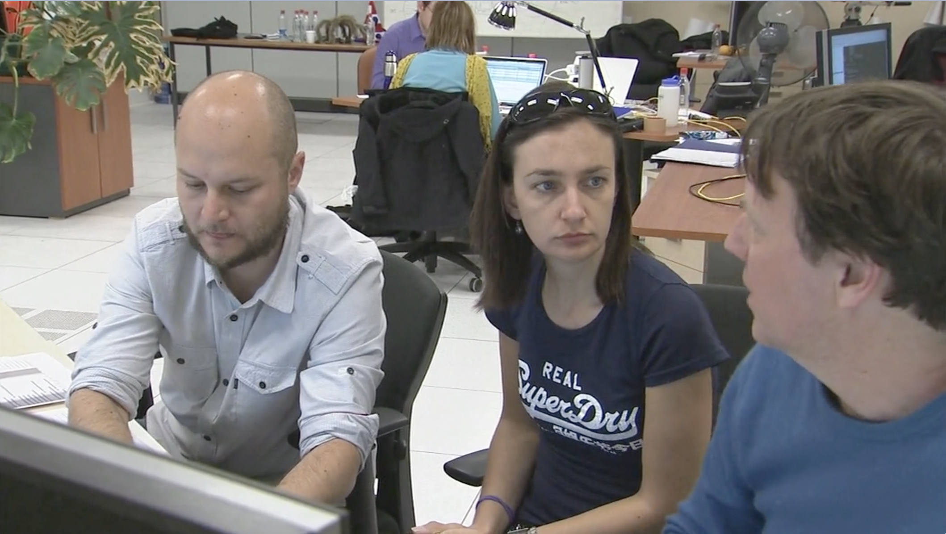
Astronomy Research + Citizen Science
+

Slide 15

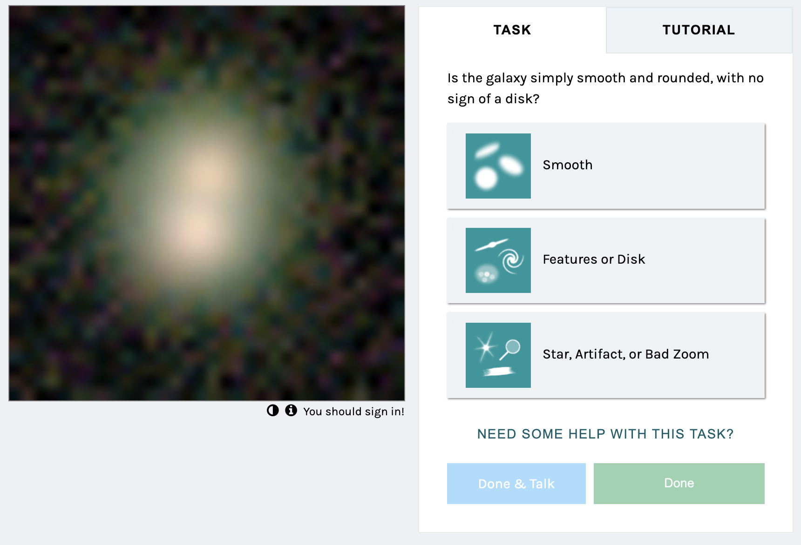
Pattern recognition and classification + Citizen Science
Galaxy Zoo @ Zooniverse
Goal: Train a model to classify morphologicaly galaxies based on their images
Datasets (> 300.000 galaxies):
Sloan Digital Sky Survey (APO, US, 2.5m)
Dark Energy Camera Legacy Survey (DECaLS) (V. Blanco Telescope, Chile, 4m)
Hawaii H2O Survey (Subaru Telescope, US, 8.2m)
Cosmic Evolution Early Research Science (CEERS) with JWST (Space, 6.5m)
Methodology:
Train a classifier with labelled data
Labels are put by thousands of volunteers with no specific field knowledge

Slide 16
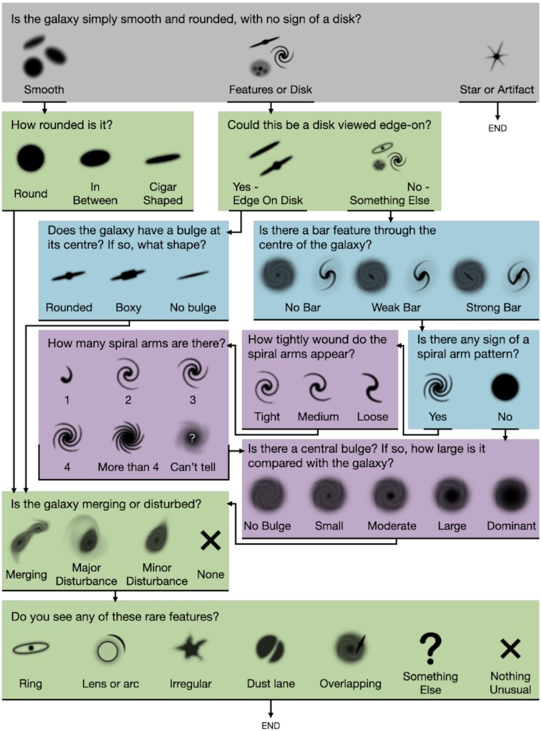
Pattern recognition and classification + Citizen Science
7.5M classifications(!) from which 140.000 get > 30 classifications
Robust classifications
Some work to be done to flag misclassifications
This enabled producing >75 publications 2008-2023
Physical properties of speficic types of Galaxies
Morphology as a function of the environment
Statistics of orientation of Galaxies (spin)
Comparision with morphologies at other wavelengths
Figure 4. Classification decision tree for GZD-5, with new icons as shown to volunteers. Questions shaded with the same colours are at the same level of branching in the tree; grey have zero-dependent questions, green one, blue two, and purple three.

Slide 17
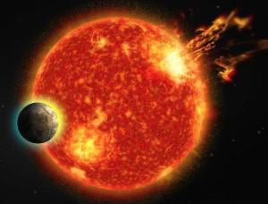
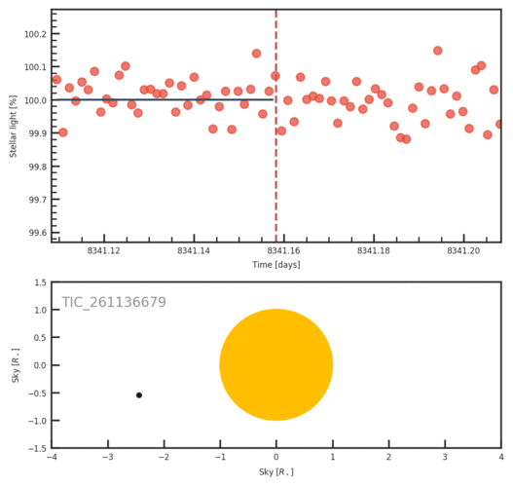
Pattern recognition and classification + Citizen Science
Planet Hunters TESS @ Zooniverse
Goal: Identify exoplanets by using the transit method.
Data: Lightcurves observed with dedicated space missions:
Kepler or TESS
Method:
Build a classifier that automatically identifies potential candidates
Volunteers help to identify tricky or borderline patterns, suggesting a classification (variable star, data glitch, potential planet)
Results:
More than 100 new planetary systems identified in Kepler data

Slide 18
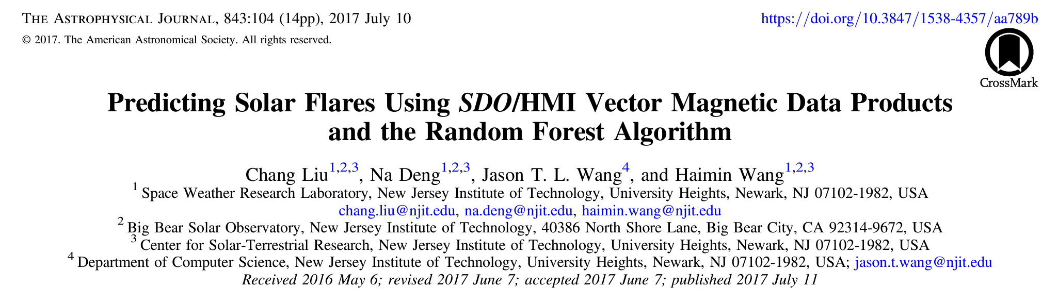
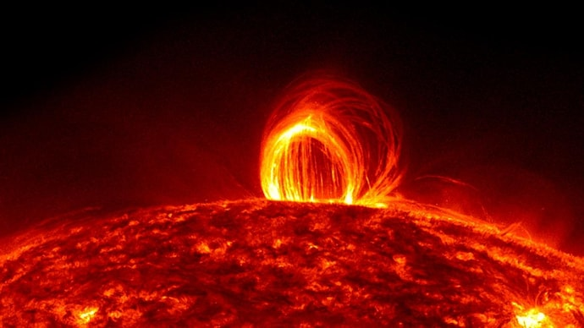
Classification and forecasting of solar flares
Catalog of actual solar X-ray flares happened between 2010 and 2016
Categorization of the solar flare emerging regions in 4 categories (B, C, M, X) according to their intensity.
Building a data base with a set of physical parameters extracted from the HMI instrument at the Solar Dynamics Observatory (SDO) at the beginning of each flare.
Train a RF classifier with these data to predict the occurrence of the different categories of flares.

Slide 19
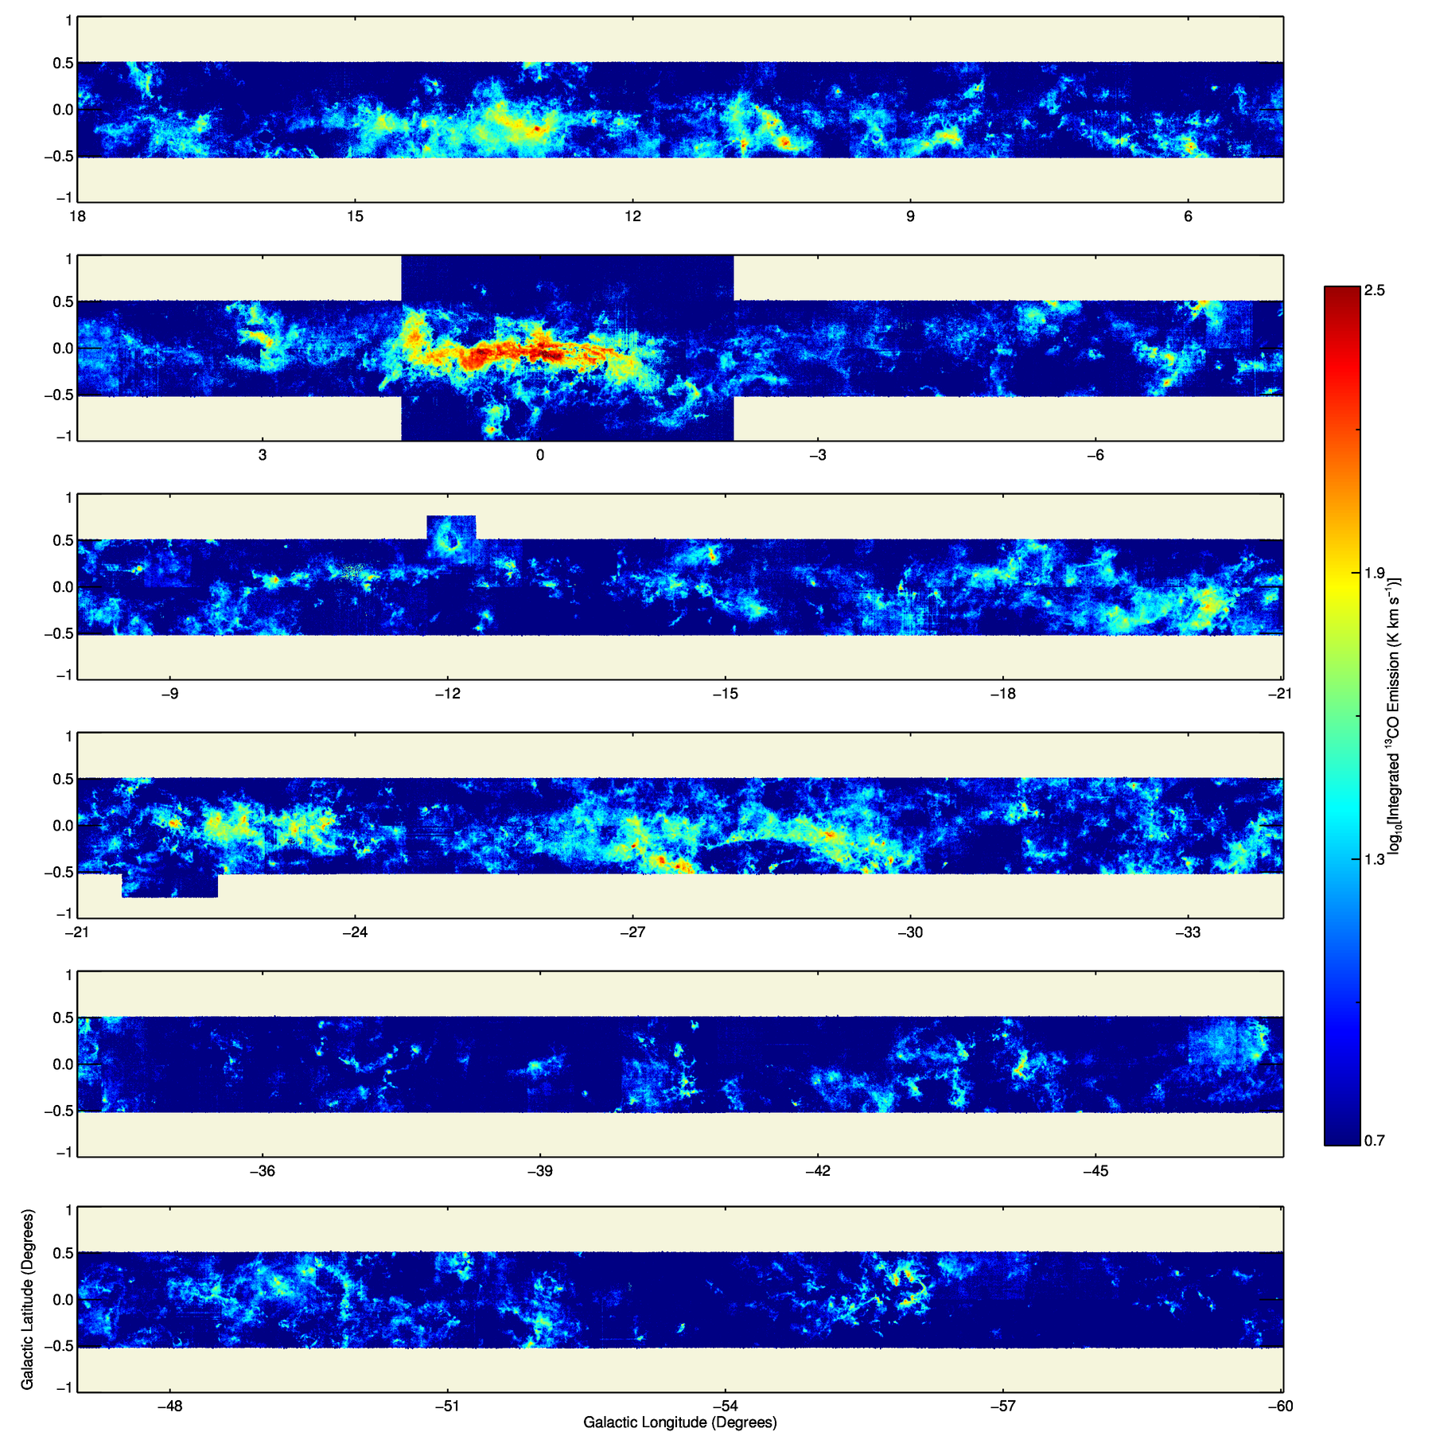
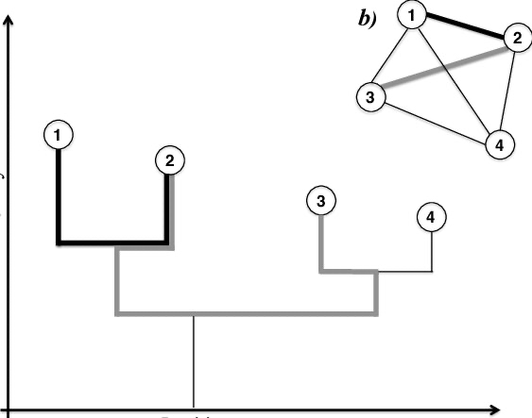
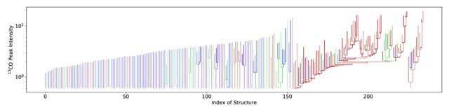
SEDIGISM*
*Structure, Excitation and Dynamics of the Inner Galactic Interstellar Medium
SCIMES segmentation algorithm based on graph theory
D. Colombo et al. (2015). MNRAS, 454, 2067
Dendrogram for G305
F. Schuller et al, A&A 601, A124 (2017)
P. Mazumbar et al. (2023) A&A 656, A101 (2021)

Slide 20
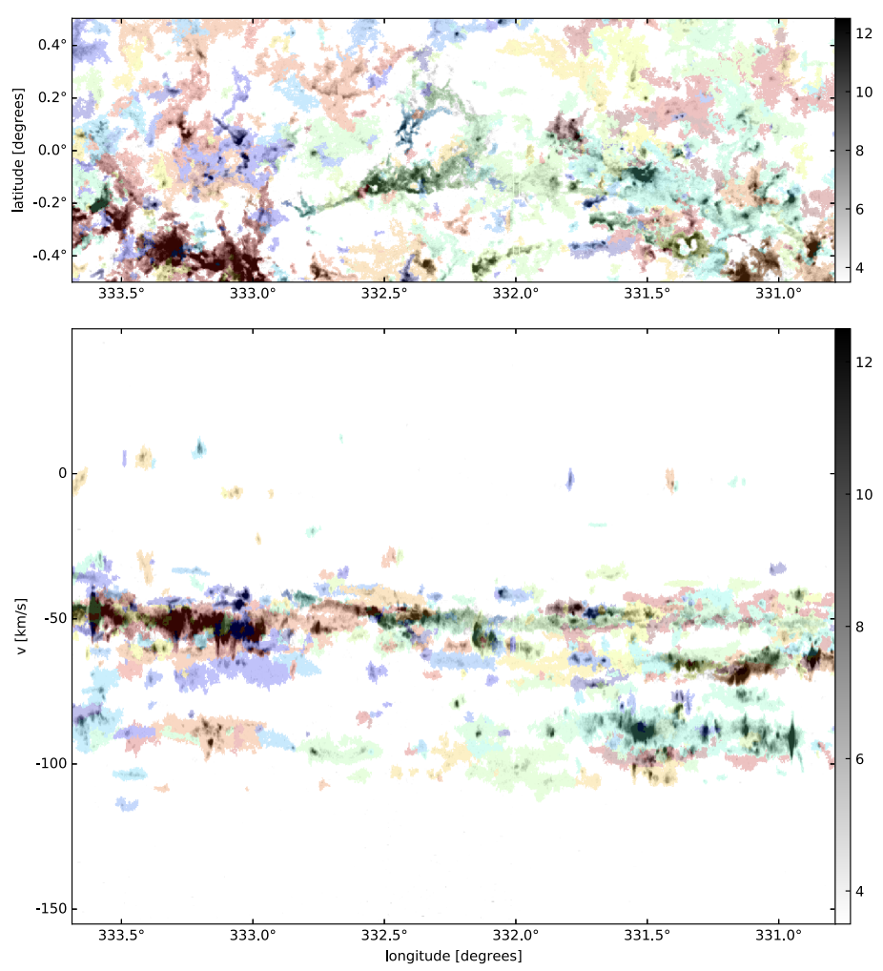
SEDIGISM*
*Structure, Excitation and Dynamics of the Inner Galactic Interstellar Medium
Catalog of >10.000 molecular clouds identified, most of them with determination of distances
Determination of the physical properties of the clouds.
Study of the distribution and dynamics of clouds as a function of the arm structures known in our Galaxy
A. Duarte-Cabral et al. (2021). MNRAS, 500, 3027

Slide 21

What is coming…

Slide 22

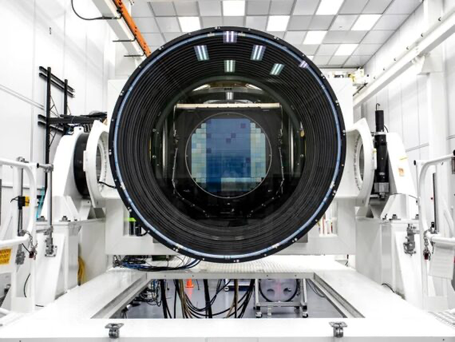
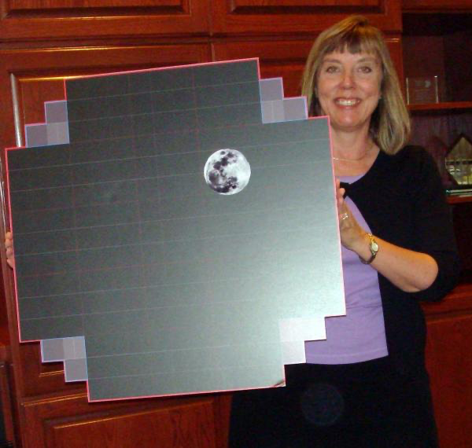
LSST: Massive data processing in quasi real time

Slide 23
LSST: Massive data processing in near real time
Cover all the visible sky every 2-3 nights
Exhaustive study of the transient sky. What has changed?
About 10 million of alerts per night (20.000 alerts per minute)
Latency of alert: 60 seconds
Classification of alerts are crucial to decide on the workflow to follow
Supernova?
NEO?
Variable star?
Micro lensing?
New cool stuff?

Slide 24

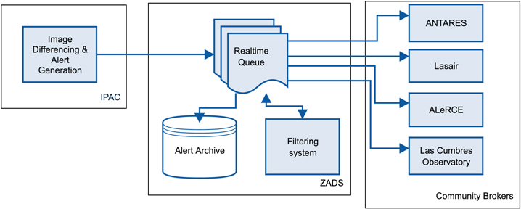


LSST prototype: Zwicky Transient Facility (ZTF)
Several brokers becoming specialized in classification of alerts by ZTF
https://alerce.science/
Fink
https://antares.noirlab.edu/
https://fink-broker.org/

Slide 25
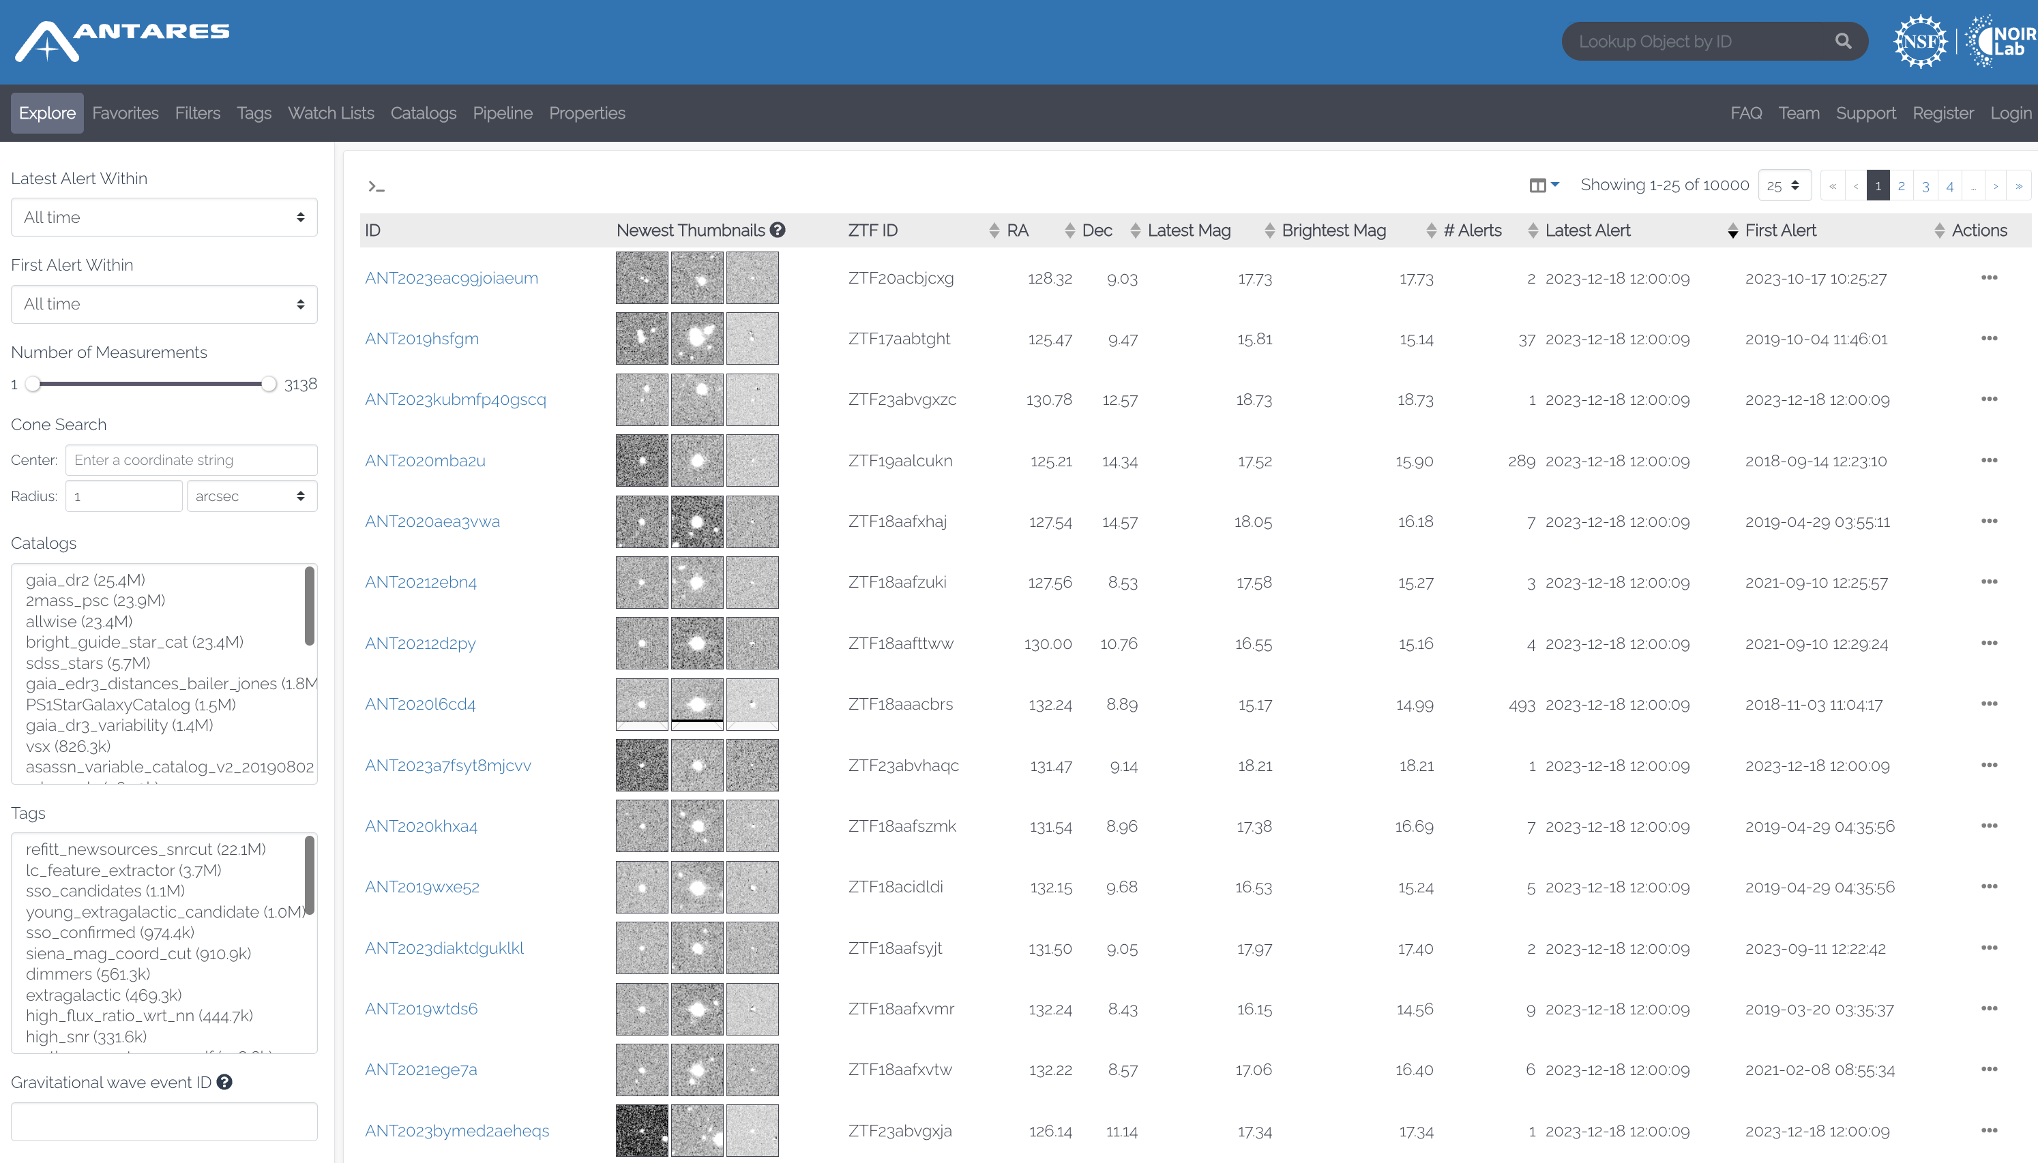
LSST prototype: Zwicky Transient Facility (ZTF)

Slide 26
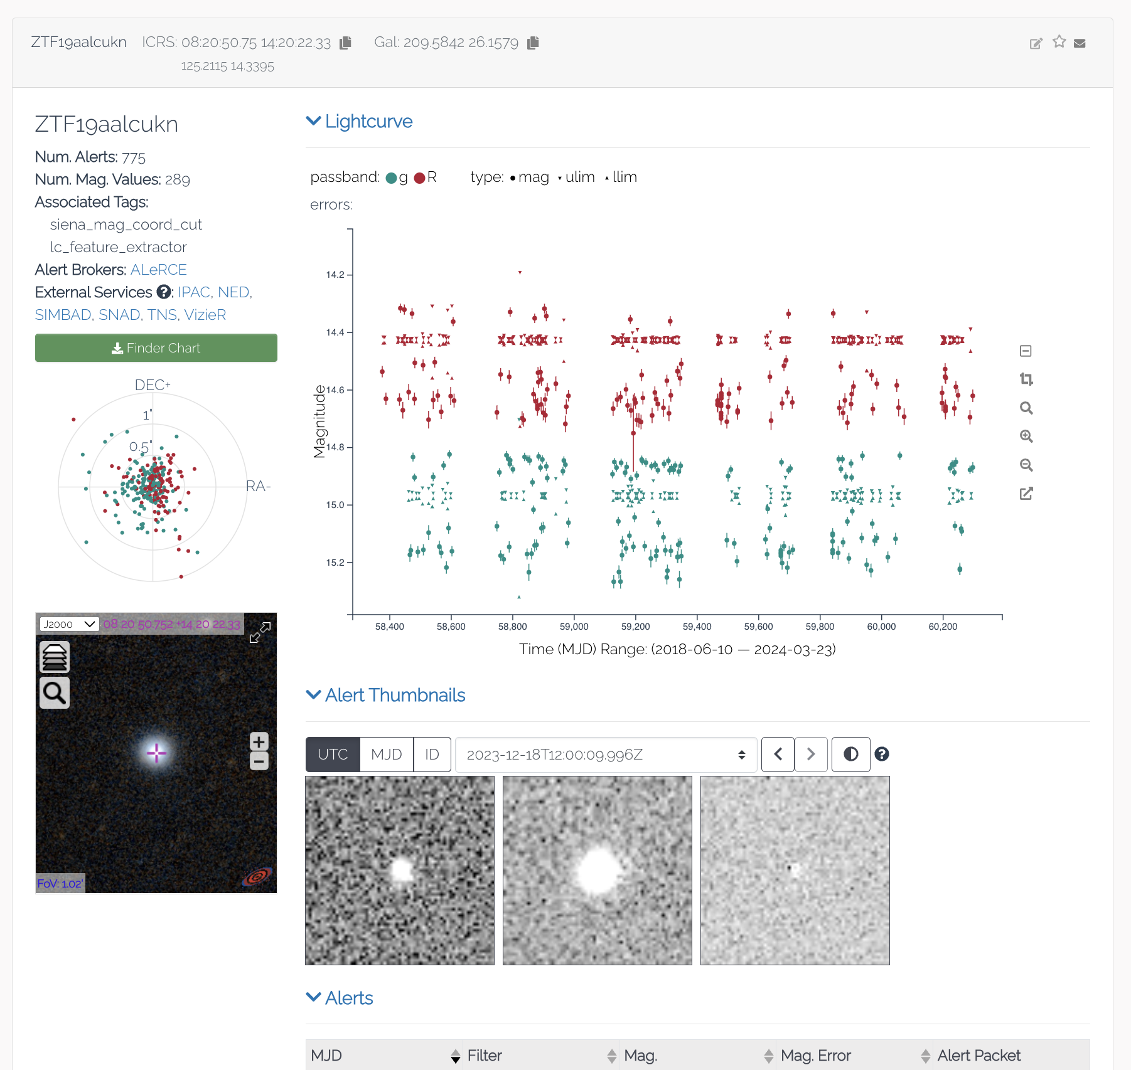
LSST prototype: Zwicky Transient Facility (ZTF)

Slide 27
Bibliography
Dalya Baron (2019). Machine Learning in Astronomy: A practical overview. arXiv:1904.07248v1
Christopher J. Fluke & Colin Jacobs (2019). Surveying the reach and maturity of machine learning and artificial intelligence in astronomy. WIREs Data Mining Knowl Discov. 2020;10:e1349. https://doi.org/10.1002/widm.1349
Željko Ivezić, Andrew J. Connolly, Jacob T. Vanderplas & Alexander Gray (2020). Statistics, data mining and machine learning in astronomy: A practical Python guide for the analysis of survey data (2nd Ed). Cambridge University Press.
José V. Rodríguez, Ignacio Rodríguez-Rodríguez, Wai Lok Woo (2022). On the application of machine learning in astronomy and astrophysics: A text-mining-based scientometric analysis. WIREs Data Mining Knowl Discov. 2022;12:e1476. https://doi.org/10.1002/widm.1476
Marc Huertas-Company & François Lanusse (2023). The Dawes Review 10: The impact of deep learning for the analysis of galaxy surveys. Publications of the Astronomical Society of Australia, 40, e001. doi:10.1017/pasa.2022.55
Michael J. Smith & James E. Geach (2023). Astronomia ex machina: a history, primer and outlook on neural networks in astronomy. R. Soc. Open Sci. 10: 221454. https://doi.org/10.1098/rsos.221454
XXX Canary Islands Winter School on Astrophysics (2018). eBook XXX Winter School: summaries, talks, references, and tutorials. https://meetings.iac.es/winterschool/2018

Slide 28
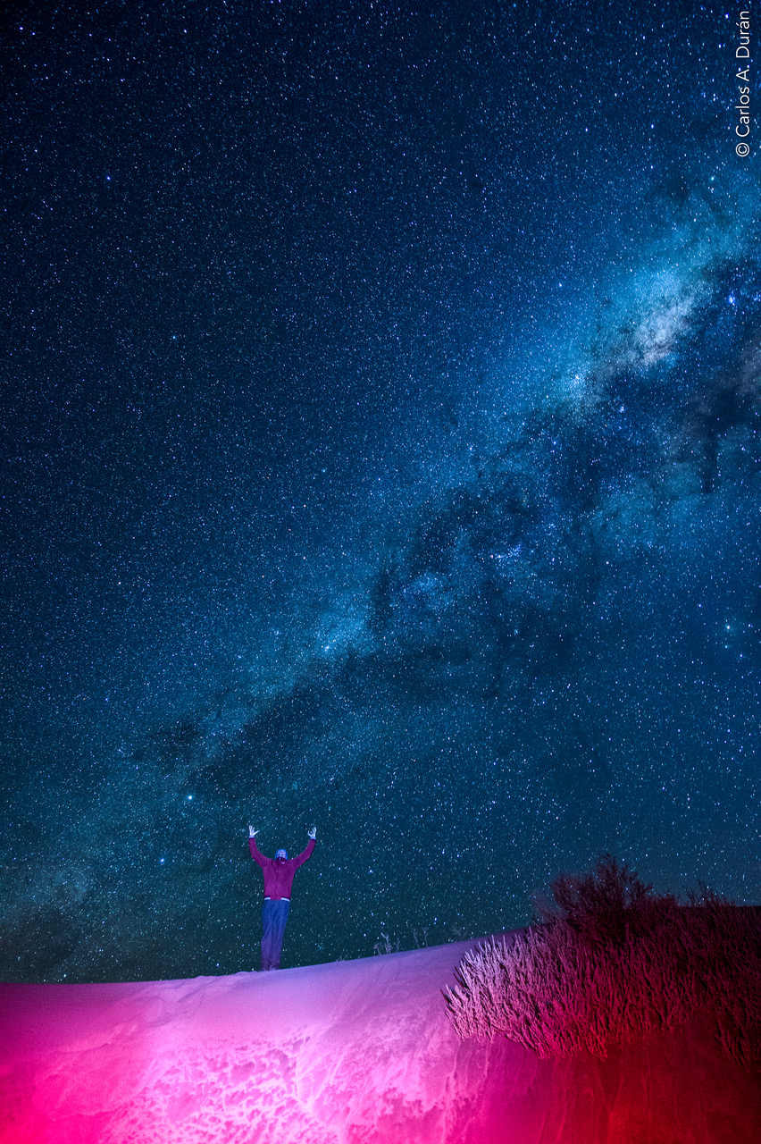
Thank you!

